Slide 1
Server Side Web Development 5COSC006W
Overview to Module

Slide 2
MODULE DETAILS
Full module title: Server-side Web Development
Module Code : 5COSC006W (UoW), 5COSC024C (IIT)
Length : 1 Semester
Lecturers
Module Leader
Ms. Jayani Harischandra(jayani.a@iit.ac.lk)
Module Lecturers
Ms.Theja Perera (theja.p@iit.ac.lk )
Mr. Isuru Kariyawasam (PT)
Ms. Pumudu Fernando
Ms. Sachni Bambaranda

Slide 3
Module Pre-requisites,
Co-requisites
*None
*Conditions apply:
Recap on;
Database - SQL
Web programming – HTML, browser scripting
YOUR 100% commitment ☺
Notes:
HTML
CSS
SQL

Slide 4
MODULE AIM
To be able to analyse, design and implement commercial web applications from a programming and database perspective
Using PHP as a server-side language to implement high-quality functional applications that appropriately fulfil user requirements

Slide 5
Module Learning Outcomes
LO1 Identify and argue merits of alternative methods for creating dynamic web sites [ICT-2 focus]
LO2 Critically evaluate various Web-related technologies and select the appropriate ones to develop a functional Web application to support the requirements of an organization [ICT-2 focus]
LO3 Demonstrate a detailed understanding of the Design and Implementation of a server-side processing solutions involving database access (create, read, update and delete), form handling, data persistence, user authentication and session handling [ICT-1 focus]
LO4 Design and Develop a user interface for the Web application using appropriate technologies [ICT-1 focus]
LO5 Carry out research and discuss issues related to emerging web application technologies. [ICT-2 focus]

Slide 6
ASSESSMENT PLAN
Phase Test 1 – 50%
Closed Exam – 1 hour
Week 8
LO3 & LO4
Phase Test 2 – 50%
Closed Exam – 1 hour
Week 12
LO1, LO2 & LO5
Qualifying marks for each component is 30% hence the student should achieve minimum 30/100 for each component
Notes:
Exact dates will be announced, most likely falling on the lecture date/time slots (both written tests)

Slide 7
MODULE DELIVERY
Single semester module
Lectures (2 hours per week)
1 hour Lecture
1 hour Tutorial in-class
Tutorials (2 hours per week)
2 hours Tutorial in-lab

Slide 8
MODULE CONTENT
Introduction to PHP & Web-related Technologies
HTML, CSS, PHP variables, control constructs
GET POST methods
Session Variables and Loops
Embedded SQL, DB connections in PHP
CRUD operations
Error Handling
Embed SQL and Date Functions

Slide 9
ESSENTIAL READING
Nixon, R. (2012). Learning PHP, MySQL, JavaScript, and CSS: A Step-by-Step Guide to Creating Dynamic Websites, 2nd ed. O'Reilly Media.
Ullman, L (2012). PHP and MySQL for Dynamic Web Sites: Visual QuickPro Guide, 4th ed. Peachpit Press.
Wenz, C (2013). PHP and MySQL Phrasebook. Addison-Wesley Professional.

Slide 10
FURTHER READING
Mendez, M. (2014), The Missing Link: An Introduction to Web Development and Programming, Open SUNY Textbooks.
Beighley, L. & Morrison, M. (2009), Head First PHP & MySQL, O'Reilly Media.
Beak, A. (2017), PHP 7 Zend Certification Study Guide: Ace the ZCE 2017-PHP Exam. Apress.

Slide 11




References
PHP Manual - http://php.net/manual/en/index.php
Other supporting material – Textbooks/ YouTube videos/ online material/ course material from credible sources
W3Schools - https://www.w3schools.com/php/
Coursera: Building Web Applications in PHP
https://www.coursera.org/learn/web-applications-php
Coursera: Building Database Applications in PHP
https://www.coursera.org/learn/database-applications-php
SoloLearn - https://www.sololearn.com/Course/PHP/

Slide 12
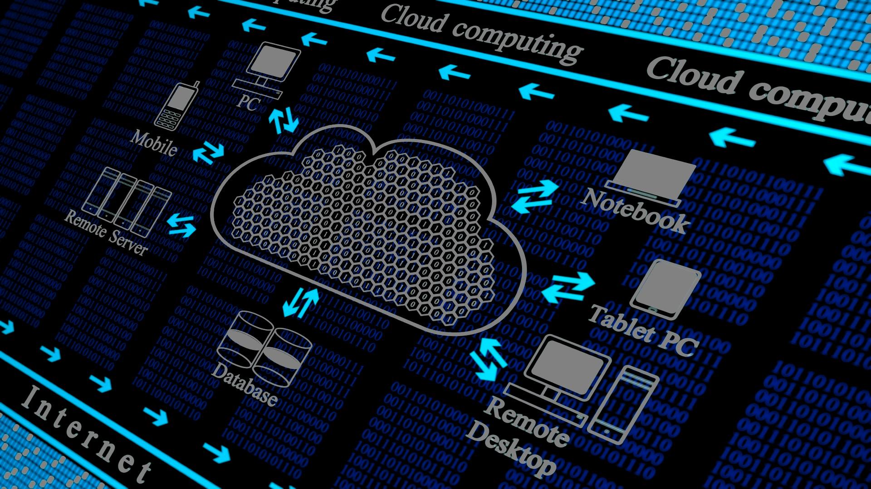
Let’s Get Started
Introduction to PHP & Server-side Web programming

Slide 13
Introduction to PHP & Server-side Web programming
Server-side Web Development - 5COSC024C.2

Slide 14
Today’s topics
Web-related Technologies
Why PHP
Uses of PHP
PHP Code Example
Request/ Response cycle
Web architecture

Slide 15
Activity-TIME
What are related Web Technologies that can be used to create dynamic websites?
What are examples for popular PHP Websites?
Notes:
Web Technologies (general term referring to the many languages, multimedia packages, frameworks that are used in conjunction with one another, to produce dynamic websites)
Php – old, but timeless
Django – python based (but python is not for web, popular for data mining, etc.)
Angular JS – javascript based
Ruby on Rails
jQuery – js based for Ajax
Bootstrap – for CSS/UI
NodeJS
MongoDb – db
Popular PHP websites - refer next 2 slides
Web Trends – Cloud Computing, Virtualisation, IaaS (Infrastructure as a Service), SaaS (Software as a service, storage as a service), PaaS (Platform as a Service)

Slide 16
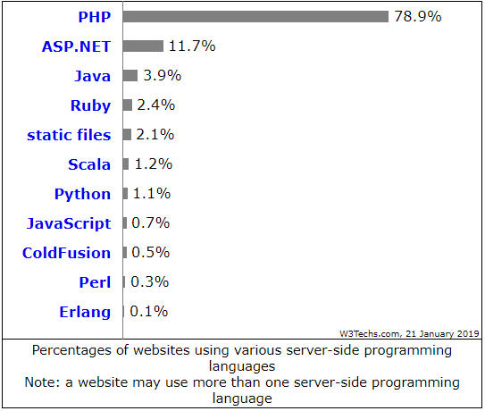
% of websites using server-side programming languages
(W3Techs, 2019)
Notes:
Popular PHP websites - refer next slide

Slide 17






Websites based on PHP
Notes:
Popular PHP websites - https://w3techs.com/technologies/details/pl-php/all/all
Facebook
Wikipedia
Yahoo
WordPress
Pinterest
Flickr
iStock
Sourceforge
Mailchimp

Slide 18
Why PHP? (PHP: Hypertext Preprocessor)
“PHP is a widely-used open source general-purpose scripting language that is especially suited for web development and can be embedded into HTML.” (The PHP Group, 2019)
Universal language for Web, to build a foundation for programming Web applications
Widely-used, open source scripting language, free to download, runs on multiple platforms
Server side scripting language that is embedded in HTML, integrated with popular databases
Notes:
PHP (recursive acronym for PHP: Hypertext Preprocessor)

Slide 19
Activity-TIME
What are the uses/ application of PHP?
Notes:
//Refer next slide for PHP uses

Slide 20
Uses of PHP
Server-side scripting (generate dynamic page content)
File handling (create, open, read, write, delete, close files)
Form handling
Database functions (add, delete, modify data in database)
Access, set, send, receive Cookies
Control user-access
Session handling
Encrypt data
Notes:
Server-side scripting - 3 things needed to make this work: the PHP parser (CGI or server module), a web server and a web browser. You need to run the web server, with a connected PHP installation. You can access the PHP program output with a web browser, viewing the PHP page through the server.
Other uses
Command line scripting
Writing desktop applications
text processing
http://php.net/manual/en/intro-whatcando.php

Slide 21
Code Example
<!DOCTYPE HTML> <html> <head> <title>Example</title> </head> <body> <?php echo “Hello World!"; ?> </body> </html>
Notes:
<?php ?> is the standard tag
Other alternatives
<? ?>
<script language=“php”> </script>

Slide 22
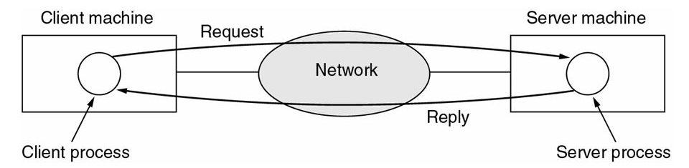
Request/ Response Cycle
Server: Service providers
Computer program or machine that provide services to (Web Services or FTP services) to other programs or users (machines).
Client: Service requesters
Computer program or machine that request the services from servers.
(Tanenbaum & Wetherall, 2011)

Slide 23
Client-Server Architecture
Client/server describes the relationship between two computer programs in which one program, the client, makes a service request from another program, the server, which fulfils the request
Client-Server Architecture
2-Tier Architecture
3-Tier Architecture
N-Tier Architecture

Slide 24
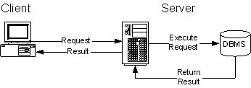
2-Tier Architecture
A two-way interaction in a client/server environment, in which the user interface is stored in the client and the data are stored in the server.
The application logic can be in either the client or the server.
Basic two-tier architecture (Clinton, 2013)

Slide 25
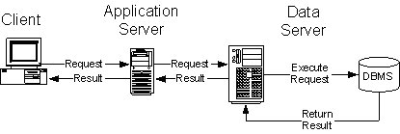
3-Tier Architecture
A three-way interaction in a client/server environment, in which the user interface is stored in the client, the bulk of the business application logic is stored in one or more servers, and the data are stored in a database server.
Basic three-tier architecture (Clinton, 2013)

Slide 26
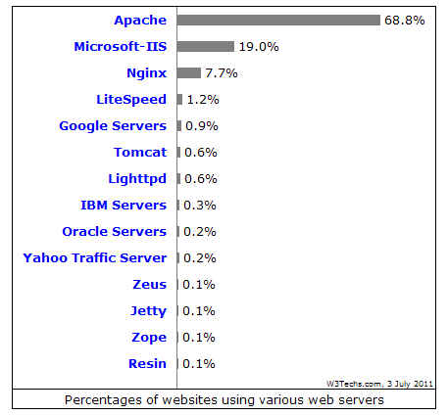



Web Servers
Any computer can be turned into a Web server by installing server software and connecting the machine to the Internet
IIS
http://www.iis.net/
Apache
http://www.apache.org/
Tomcat
http://tomcat.apache.org/
Glassfish
https://glassfish.dev.java.net/

Slide 27
Activity-TIME
Compare & Contrast
3-tier/ multi-tier
Front-end/ Back-end
Logical/ Physical
Client-side/ Server-side

Slide 28
Home-work
Setup PHP/MySql XAMPP Environment
Install/ configure XAMPP
E.g. Installing XAMPP on Windows for PHP/MySql https://www.wa4e.com/software-win.php (Severance, 2017)

Slide 29
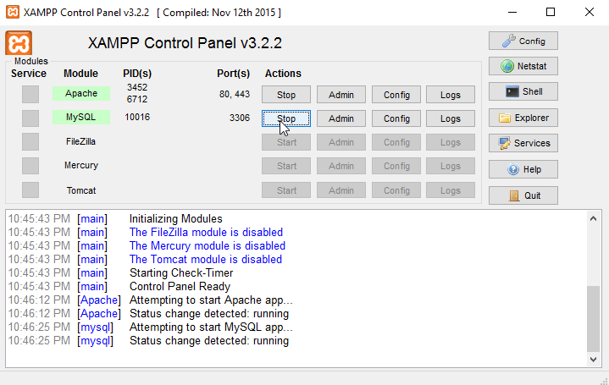
(Severance, 2017)

Slide 30
Summary
Module Introduction, Module Delivery Plan, Assessment deadlines
Introduction to PHP, uses of PHP, PHP Code Example
Web Technologies, Request-Response cycle, Web Architecture

Slide 31
NEXT LESSON
HTML, CSS, PHP variables, control constructs

Slide 32
References
Clinton, S. (2013). Delphi 2 – Developing for Multi-Tier Distributed Computing Architectures with Delphi Client/Server Suite 2.0. Embarcadero Technologies. Available from http://edn.embarcadero.com/article/10343 [Accessed 24 September 2018]
Severance, C. (2017). Installing XAMPP on Windows for PHP/MySql. YouTube. Available from https://www.youtube.com/watch?v=X0_pthMQPMM [Accessed 15 Jan 2019]
Tanenbaum, A & Wetherall, D. (2011). Computer Networks. 5th ed. Boston: Pearson. Available from http://iips.icci.edu.iq/images/exam/Computer-Networks---A-Tanenbaum---5th-edition.pdf [Accessed 24 September 2018]
The PHP Group (2019). PHP: What is PHP? – Manual. php.net. Available from http://php.net/manual/en/intro-whatis.php [Accessed 15 Jan 2019]
W3Techs (2019). Usage of server-side programming languages for websites. W3Techs. Available from https://w3techs.com/technologies/overview/programming_language/all [Accessed 21 January 2019]

